Slide 1

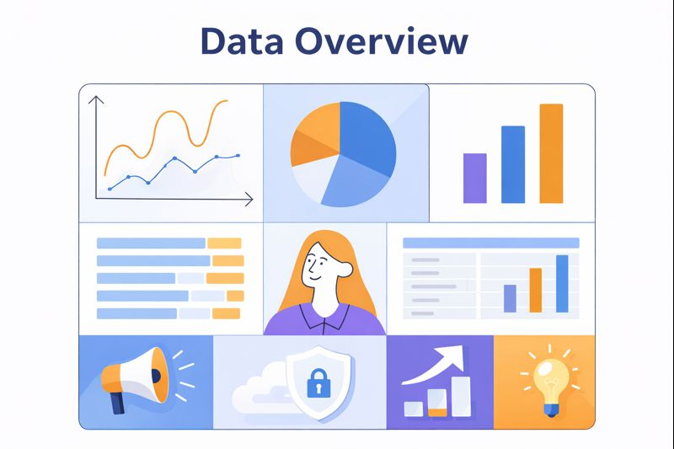

SURYAHUB
CUSTOMER LOYALTY & PURCHASE BEHAVIOR ANALYSIS
June 2025
Prepared by : Rizky Ratna Sari | Data Analyst

Slide 2
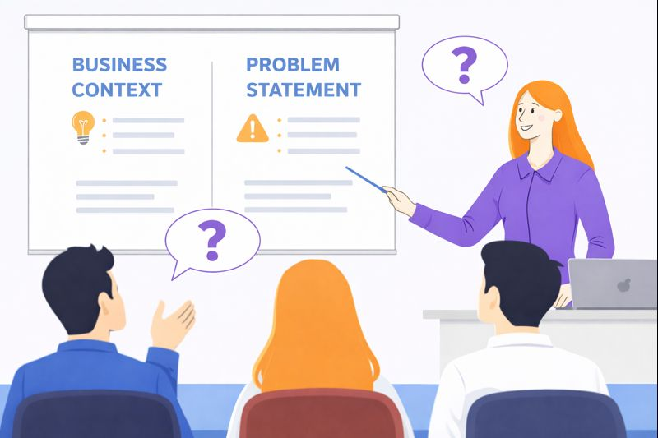
Why This Analysis Matters
Transaction volume increased compared to previous months.
However, revenue per customer remains stagnant.
Marketing efforts are not yet focused on the most valuable customer segments or channels.
Business Questions :
Is the current loyalty program effective?
Which customer segments and channels should be prioritized to increase repeat purchase and revenue per customer?

Slide 3

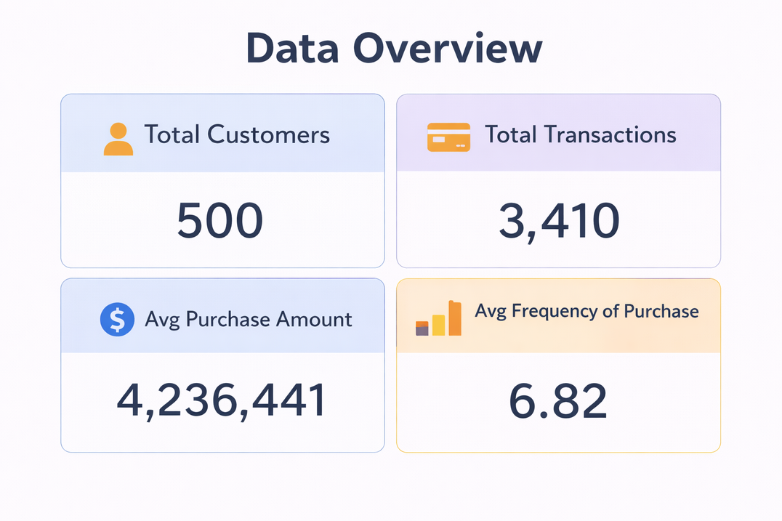
DATA OVERVIEW
This dataset summarizes customer activity and purchase behavior for June 2025.

Slide 4
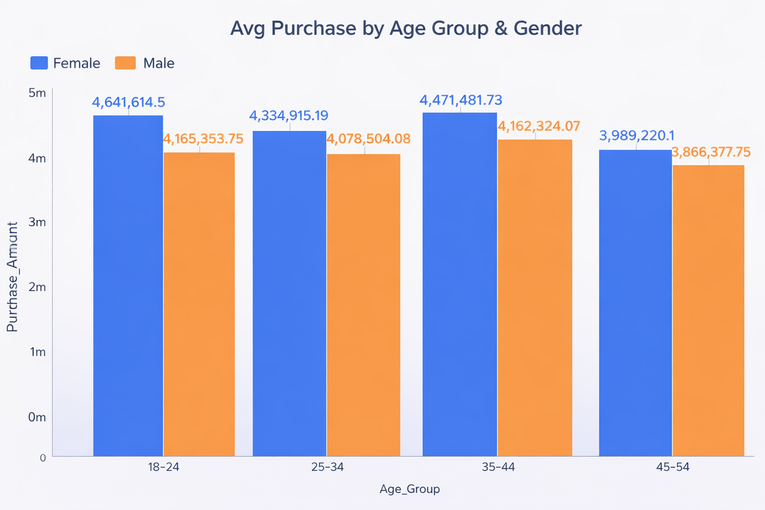

CUSTOMER DEMOGRAPHICS
Younger Customers (18–24) Show the Highest Average Purchase Value
Customers aged 18–24 generate the highest average purchase amount across both genders.
Female customers demonstrate slightly higher transaction activity across age groups.
This segment represents a key high-value demographic group

Slide 5
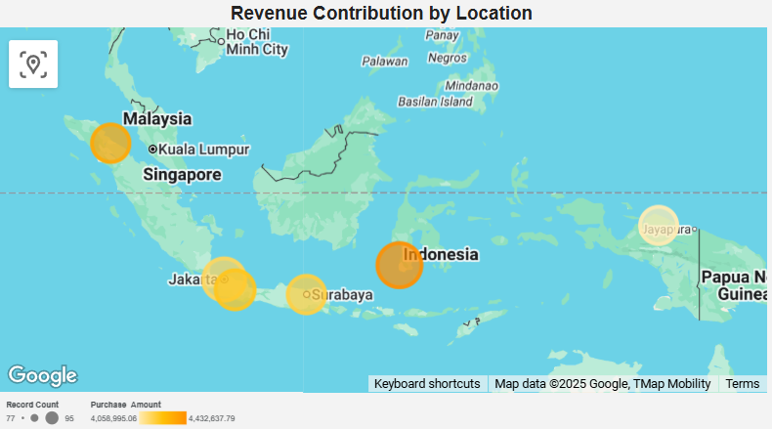

GEOGRAPHIC PERFORMANCE
Revenue Is Concentrated in Major Urban Locations
Customer revenue is concentrated in a few major cities.
Top locations include Jakarta, Makassar, Surabaya, Bandung, and Medan.
These cities show strong potential for location-based marketing strategies.

Slide 6
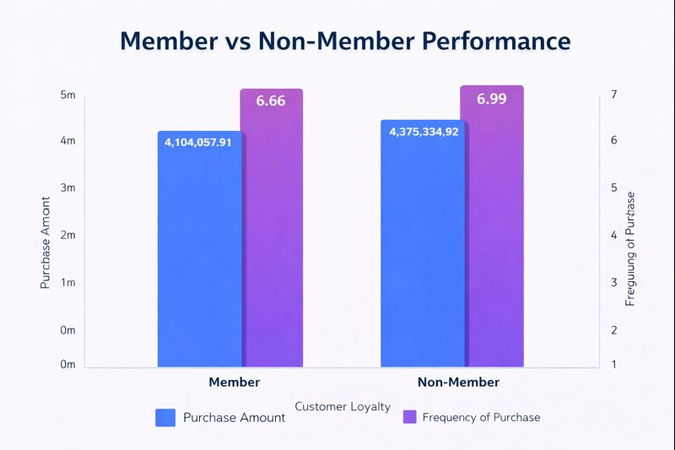
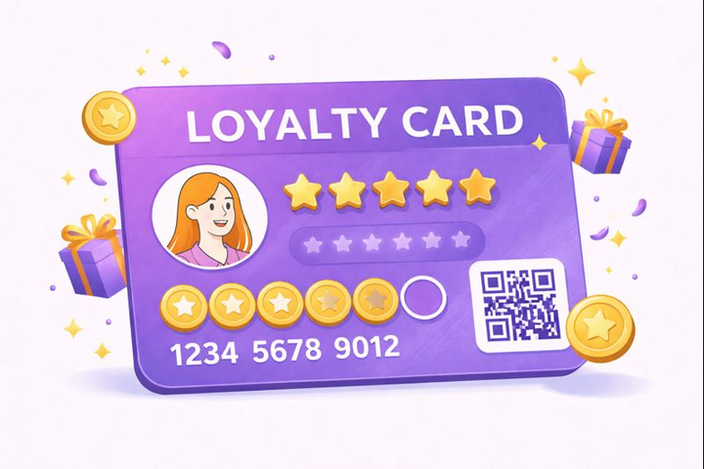
LOYALTY PROGRAM EFFECTIVENESS
The Current Loyalty Program Shows Limited Impact
Loyalty program members do not significantly outperform non-members.
No meaningful difference in average purchase amount or purchase frequency.
This suggests the current loyalty program lacks strong incentives to drive repeat purchase.

Slide 7
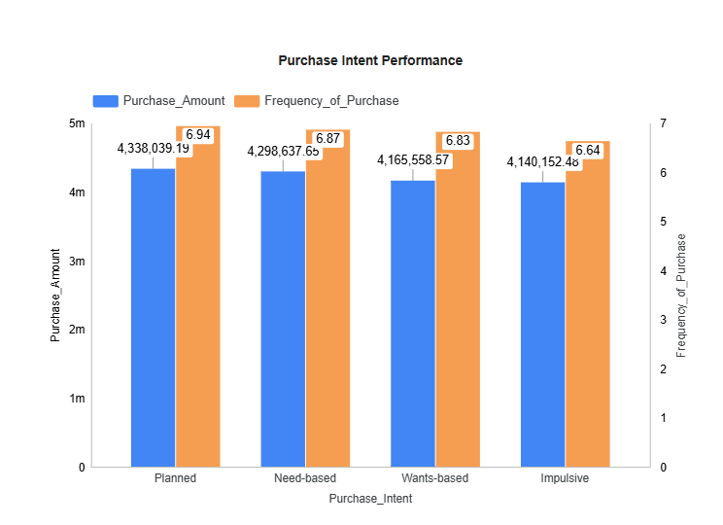

PURCHASE INTENT INSIGHT
Planned Buyers Drive Higher Value and Frequency
Planned buyers generate the highest average purchase amount.
They also show the highest purchase frequency.
Revenue is driven more by intentional purchases than impulsive behavior.

Slide 8
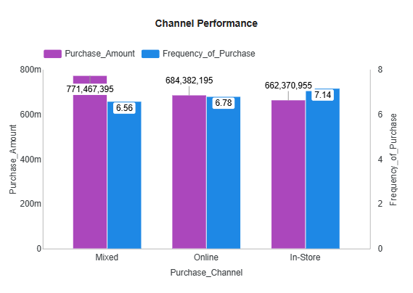
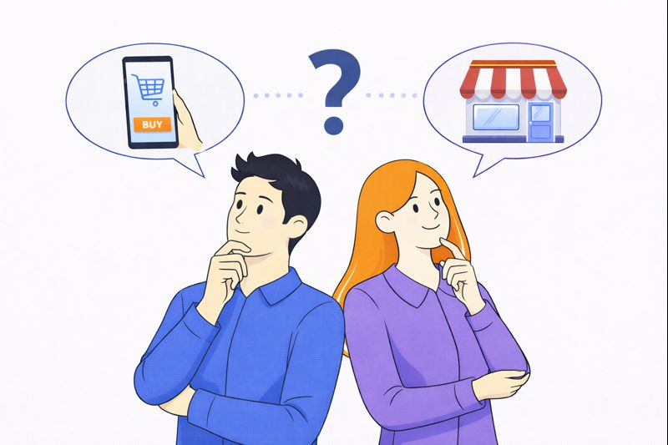
CHANNEL PERFORMANCE
Omnichannel Customers Deliver Higher Overall Value
Mixed-channel customers generate the highest purchase value.
In-store customers show the highest purchase frequency.
Channel flexibility supports repeat purchasing behavior.

Slide 9

STRATEGIC RECOMMENDATIONS
Actionable Recommendations
Redesign the loyalty program with value-based rewards instead of discounts.
Focus campaigns on high-value younger customers (18–24).
Activate planned buyers through bundles and scheduled promotions.
Strengthen omnichannel integration between online and in-store channels.

Slide 10

FROM INSIGHTS TO ACTION
Expected Impact
Increased repeat purchase
Improved revenue per customer
Stronger customer retention
Next Steps
Run a 4-week campaign test in July 2025
Measure purchase frequency and revenue per customer
Scale high-performing strategies

Slide 11

THANK YOU
For Your Attention

